Slide 1

TUGA IT 2016
Sandro Pereira
Integration MVP
BizTalk Server Deep Dive Tips and Tricks
For Developers and Admins
LISBON, PORTUGAL

Slide 2




THANK YOU TO OUR SPONSORS

Slide 3















THANK YOU TO OUR TEAM
ANDRÉ BATISTA
ANDRÉ MELANCIA
ANDRÉ VALA
ANTÓNIO LOURENÇO
BRUNO LOPES
CLÁUDIO SILVA
NIKO NEUGEBAUER
NUNO CANCELO
PAULO MATOS
PEDRO SIMÕES
RICARDO CABRAL
RUI BASTOS
RUI REIS
SANDRA MORGADO
SANDRO PEREIRA

Slide 4



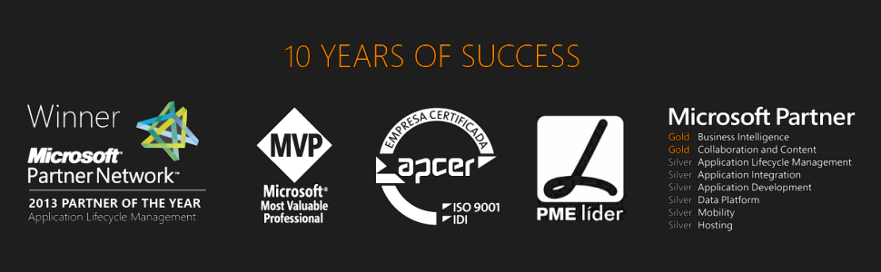



Good afternoon….
Sandro Pereira
Senior Software Developer | Microsoft Azure MVP
sandro.pereira@devscope.net
linkedin.com/in/sandropereira
@sandro_asp
sandroaspbiztalkblog.wordpress.com
+351 223 751 350
www.devscope.net

Slide 5


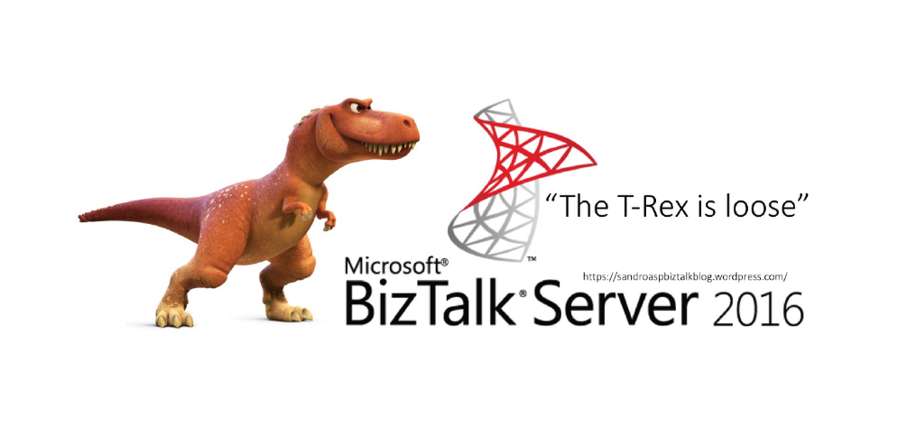
BizTalk Server 2016 stickers
Tweet #tugait
@sandro_asp
“The T-Rex is loose”

Slide 6
Agenda for this session
BizTalk Server tips and tricks for Managers or Architects
BizTalk Server Project Migrations
BizTalk Server tips and tricks for Administrators
Maintain the health of BizTalk platforms
BizTalk Server tips and tricks for Developers
Good tools and techniques to produce eficiente solutions and as quickly as possible
Notes:
It’s critical to use good tools and techniques to produce working solutions as quickly as possible and at the same time, given the increase the requirements and number of applications organizations develop today. But at the same time, it's also critical to maintain the health of the entire platform. In this session, which I'll try to be a very interactive session (so be prepare to participate), I'll address and share some useful BizTalk Server Tips and Tricks (and Workarounds) both for developers and administrators. Covering some topics like RosettaNet, SAP, database maintenance, debatching, out-of-the-box pipelines vs custom pipelines and many more.

Slide 7

What your Manager or
Client wants from you…
Notes:
Make a proper effort estimation

Slide 8
TIP #1 – BizTalk Project Migration
Types of migrations:
AS IS – Without any non-mandatory changes
Analyse and check all the points to improve and then migrate/recreate the integration project will all the improvements or new requirements.
AS IS migration steps required?
Open BizTalk Visual Studio solution
Fix the .NET Version
Fix Strong Name Key
Fix deployment properties…
…. And rebuild
But not always is that so simple!

Slide 9


TIP #1 – BizTalk Project Migration
Custom Adapters
JUST REBUILD – Open VS, Fix .NET version and deploy
WARNING: Adapters registration ID’s don’t conflict
Custom Pipelines
JUST REBUILD – Open VS, Fix .NET version and deploy
Custom Functoids
JUST REBUILD – Open VS, Fix .NET version and deploy
WARNING: Functoid ID’s don’t conflict
Schemas
JUST REBUILD – Open VS, Fix .NET version and deploy
CRITICAL WARNING: SAP Adapter
You may need to rebuild all the schemas, maps and orchestrations

Slide 10

TIP #1 – BizTalk Project Migration
Maps
30% JUST REBUILD – Open VS, Fix .NET version and deploy
CRITICAL WARNING: New Transformation engine “XslCompiledTransform” versus the “XslTransform”
THEY ARE NOW 100% COMPATIBLE
Change in Scripting Functoid Boolean Parameter Behavior (https://support.microsoft.com/en-us/kb/2887564)
Scripting functoid cannot return null out of an inline C# method
Passing Null values around chain functoids in not simple anymore
Helper classes used in maps cannot use overloading
Only public methods may be called from XPath expressions
Passing a node to a helper class as a “XpathNodeIterator” now requires a Node.MoveNext to select the first node
…
SOME OF THEM DON'T GIVE ERRORS WHILE COMPILING

Slide 11
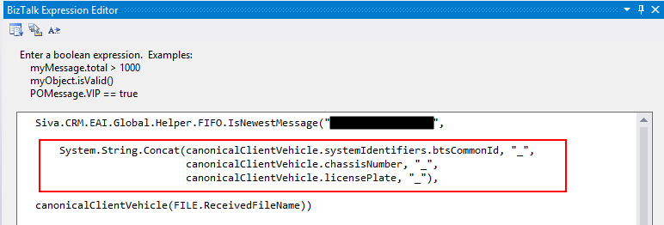
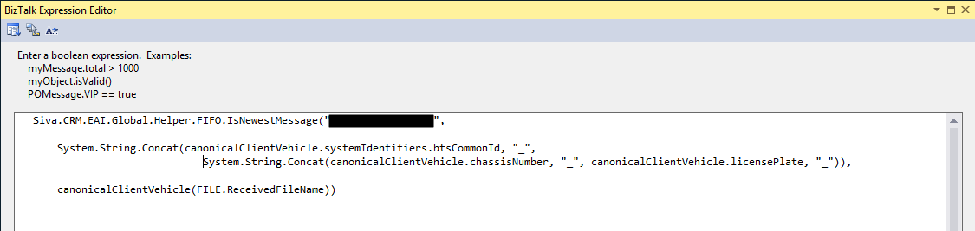
TIP #1 – BizTalk Project Migration
Orchestrations
JUST REBUILD – Open VS, Fix .NET version and deploy
WARNING: String concat behaviors

Slide 12
TIP #2 – Base your decision by…
The number of projects you have to migrate
By the structure of Visual Studio solutions
The number of features you have to migrate
Cross references databases
BAM OLAP
EDI and others…
The adapters that you need to migrate
The “old” SAP Adapter is forever gone!
You still have SQL, SOAP Adapter, …
The number of transformations (maps) that exist in the solutions
EDI, BAM OLAP or Cross References
can provide some challenges!
A good Visual Studio solution structure is really important!
SAP adapter is probably the only adapter that was really discontinuous!
The number of maps you have!

Slide 13
TIP #2 – Base your decision by…
Build 3 Env + 2 Custom adapters + BTS 2006R2 17 Integration Solutions (with SAP) in…
Build 3 Env + 2 Custom adapters + BTS 2006R2 10 Integration Solutions (with BAM OLAP) in…
Build 2 Env + 2 Custom adapters + BTS 2004 5 Integration Solutions (with Cross references and VS Solution with 210 projects) – no documentation in…
…less than 40 days
…less than 25 days
…less than 40 days

Slide 14

What about EXTENSIBILITY…
…what’s new?

Slide 15

TIP #3 – Meet Grabby! (Open Source Community project)
Let’s be completely honest…
There isn't any major revolution since 2004!
2006: BizTalk Administratin Console
2006 R2: Support for WCF Adapters
2009:
2010: New Trading Partner Management
2013: New Map Engine, Support Cloud
2013 R2: JSON
2016: Always On (that’s SQL!)
Until now… Now you will be able to easily extend your BizTalk Server…
Taking coffee with BizTalk will be possible…
… the limit will be your imagination!
With BizTalk GrabCaster Adapter… you will be able to embedded a microengine (GrabCaster engine) within the BizTalk Server engine extending the internal capabilities and providing a very easy way to solve any complex integration problem… even without code!
Notes:
It is possible to extend the framework by writing your own:
MetaInstruction and Instruction classes in assemblies
which should be deployed to the GAC
Creating vocabulary definitions that correspond to public methods on your MetaInstructions, and then using the AddMetaInstruction vocabulary definition in the BREPipelineFramework vocabulary in InstructionLoaderPolicy BRE Policies which will allow you to use the your custom vocabularies in the ExecutionPolicy.

Slide 16

That st**** Developer….
For…
Administrators
…that always try to difficult the
developer’s life style
Notes:
It is for these type of person… and I will start with this tip…

Slide 17
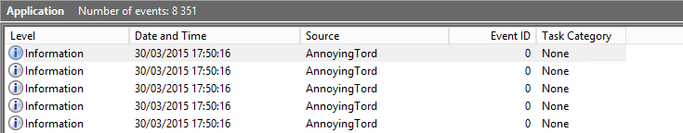
TIP #4 – Trying to annoy Tord: PowerShell!
By writing unnecessary information Application Log
EsbExceptionDb BTARNARCHIVE
EsbItineraryDb BTARNCONFIG
UDDI3 BTARNDATA
What the Admin does normally?
Ask the developer to change is code, that already is deployed in all the environments, to not write in the application log
Developers will try to find a thousand excuses for explaining why such information is important
What the Admin should do?
Change is hard - Getting others to change can be impossible or a big challenge
Let the developer by happy by writing in the Event Viewer
But take back the control of your environment by easily creating or using PowerShell to move this logs
https://gallery.technet.microsoft.com/scriptcenter/BizTalk-DevOps-Moving-an-e4c23236
Notes:
I love this tip… you all remember my dear friend Tord Glad Nordahl complaining every year in his session about Developers writing unnecessary information Application Log… and for they do not use the Event Viewer… well I partially agree with him… you shouldn’t write custom application errors, warnings of information in the Application Log… but you can use a custom log for that I really don’t care about that since you do not use the Application Log to write these stuff
What the Admin does normally?
Ask the developer to change is code, that already is deployed in all the environments, to not write in the application log
And they will try to find a thousand excuses for explaining why such information is important
My advice:
Let the developer by happy by writing in the Event Viewer
But take back the control of your environment by easily creating or using PowerShell

Slide 18

TIP #5 – What RosettaNet, ESB, UDDI have in common?
Custom Databases
EsbExceptionDb BTARNARCHIVE
EsbItineraryDb BTARNCONFIG
UDDI3 BTARNDATA
Optional features
Do you think that these databases are being backuped?
Backup Other Databases
C:\Program Files (x86)\Microsoft BizTalk Server 2013 R2\Schema
Backup_Setup_All_Procs.sql
Backup_Setup_All_Tables.sql
Modify the adm_OtherBackupDatabases table to include a row for each of your custom databases
https://msdn.microsoft.com/en-us/library/aa561198.aspx
Notes:
Have you had the time to think about what is some features like RosettaNet, ESB or UDDI have in common?
Well, all of them have custom databases and all of them are optional features
The important question here, because they have custom databases, is: Do you think that these databases are being backuped? And the data inside are saved?
And the response is NO… by default the BizTalk jobs don’t perform any operations in this databases.
Fortunately for us, Microsoft provides two SQL Scripts that you need to run against this databases in other to extend the standard backup mechanisms but you also need to modify the adm_OtherBackupDatabases table to include a row for each of your custom databases.

Slide 19
TIP #6 – BizTalk MarkLog tables
All Databases with the exception of BAMStarSchema and Custom Databases (ESB, UDDI, RosettaNet) have a MarkLog table
By default each 15 minutes, a string is stored on that table
And there isn’t any job that cleans these tables!
Solution by provide by Microsoft: using Terminator Tool
BAMAlertsApplication
BAMArchive
BAMPrimaryImport
BizTalkDTADb
BizTalkMgmtDb
BizTalkMsgBoxDb
BizTalkRuleEngineDb
SSODB
Holding all the transaction marks created by the 3th step (MarkAndBackUpLog) of the ‘Backup BizTalk Server’ job
No Cleanup process!
Tables are always growing
Clean up the MarkLog table with Terminator?!?
Cleaning MarkLog Tables According to Some of the Best Practices:
sp_DeleteBackupHistoryAndMarkLogsHistory
Copy of sp_DeleteBackupHistory with extended functionalities
Credits: Tord Glad Nordahl, Rui Romano, Pedro Sousa, Mikael Sand and me
https://gallery.technet.microsoft.com/BizTalk-Server-Cleaning-15a1b070
https://gallery.technet.microsoft.com/BizTalk-Server-Cleaning-15a1b070
Notes:
All the BizTalk database which is being backed up by the 'Backup BizTalk Server' job, so all databases with the exception of the BAM Star Schema database (BAMStarSchema), has one table called “MarkLog”.
By default each 15 minutes, a string is stored on that table, created by the 3th step (MarkAndBackUpLog) of the ‘Backup BizTalk Server’ job. This tables are holding all the transaction marks
And there isn’t any job that cleans these tables so this tables are always growing unnecessarily… the solution provide by Microsoft is using Terminator Tool… which means stop your environment for what… to purge all the data from these tables
Luckily for us…. You don’t need to do that… I decide to create a stored procedure to extend the delete history capabilities of BizTalk to include this tables according to some best practices
Credits also to Tord Glad Nordahl, Rui Romano, Pedro Sousa and Mikael Sand that helped me to create and improve this script
I really think that Microsoft should take this script, review it and include in the next version or as a hotfix

Slide 20
TIP #7 – Take control of your environment: Tracking Data
By Default Full tracking enable
Because it's easier to debug and see what is happening with your new applications
Does Developer’s remember to disable it?
No! And actually…
they don’t care about that -- is not there task to do it
and they don't know the proper configurations that should be apply into production
What the Admin should do?
Asking developers to Change their behavior can be big challenge… or even impossible!
Let the developer be happy thinking they are annoying you
This can be an annoying and time consuming operation
But take back the control of your environment by easily creating or using PowerShell to automate this task
https://gallery.technet.microsoft.com/scriptcenter/BizTalk-DevOps-How-to-c1ee8b1b
Notes:
Normally Developers have in their environments Full tracking Enable because it's easier to debug and see what is happening with your new applications
Does Developer’s remember to disable it before they create the resources to put in production?
No! And actually… they don’t care about that -- is not there task to do it
And sometimes they don't know the right configurations that should be apply into production
This can be an annoying and time consuming operation and asking developers to change their
My advice is… take back the control of your environment
These tasks can be easily automated and configured by easily creating or using PowerShell
To Disabling all Tracking or enable just the important ones at the application level or addressing all of them
You lose 1 day developing these scripts and then you do not need to worry any more
Ok enough of admin tips… And now Do you know what I mean about Developer Tips?...

Slide 21
TIP #8 – Installing Custom Adapters
What the Admin should do to install them on a 64-bit machine?
A) Double click CustomAdapter.reg
B) Open a 32-bit command prompt:
%windir%\SysWoW64\cmd.exe
<Adapter installation directory>\CustomAdapter.reg
Common problem Unique ID’s
[HKEY_CLASSES_ROOT\CLSID\{62018D08-281A-415b-A6D3-6172E3762867}]
@="Static DotNetFile Adapter"
"AppID"="{12A6EBAA-CF68-4B58-B36E-A5A19B22C04E}"
https://msdn.microsoft.com/en-us/library/aa560561.aspx
What the Admin should do?
A) Ensure that you generate new guids
B) Or use the Adapter Registry Wizard
<Installation Path>\SDK\Utilities\AdapterRegistryWizard\
https://msdn.microsoft.com/en-us/library/aa578379.aspx

Slide 22
TIP #9 – The local messaging archive folder
Very common in integration scenarios: Message archiving
To see messages being archived locally into the hard drive:
either by using a pipeline component
or by simple using the default functionalities in BizTalk like: filters
Common problem we will find with these kind of approach's?
Everyone forgets to create maintenance plans
The most critical → disk full
Many files in a folder can cause performance problems
What the Admin should do?
You can easily script this type of task since day one by using PowerShell or other tools
And ensure that these folders are properly monitored and cleaned from time to time
https://gallery.technet.microsoft.com/BizTalk-DevOps-manage-d1d512e4

Slide 23
TIP #10 – Use PowerShell to monitor your environment
One of the principal needs for BizTalk Administrators is the ability to monitor the health of BizTalk environments on a regular basis and react promptly to solve any possible issues that may appear in order to keep your BizTalk Server applications accessible to your users/organization.
DevOps PowerShell Samples to monitor BizTalk environments…
… and you even can have Auto Healing capabilities!
Monitoring Host Instances with Auto-Healing capabilities
https://sandroaspbiztalkblog.wordpress.com/2016/02/16/biztalk-devops-monitor-your-biztalk-environment-using-powershell-monitoring-host-instances-with-auto-healing-capabilities/
Monitoring Ports (Stopped/disabled/unelisted) with Auto-Healing capabilities (https://goo.gl/qBEyLM/)
Monitoring Suspended Service Instances with Auto-Healing capabilities (https://goo.gl/pBvVGF/)
Schedule Message Box Viewer or BizTalk Health Monitor and customize notification alerts with PowerShell (https://goo.gl/rlt76y/)
Monitoring BizTalk SQL Agent Jobs (https://goo.gl/TLo5Az)
Monitoring Disk Space (https://goo.gl/AX0jq8)

Slide 24

For… Developers
I'm a Developer… not a magician!
…thinking in debatching mode
in a unrecoverable
interchange mode
Notes:
It is for these type of person… thinking in debatching mode and in unrecoverable interchange mode too

Slide 25
TIP #11 – Debatching messages
What developers normally do?
Create an Envelope Schema
Create a Schema
Create a Custom pipeline
usually a replica of XMLReceive pipeline
Do I really need to do all of this?
Well you can but…
Normally you don’t need to create a custom pipeline to accomplish this.
Important considerations
If you want to debatch and validate probably it make sense to create a Custom Pipeline, othwerwise it does make sense
Recoverable Interchange Processing feature.
Notes:
What developers normally do?
Create an Envelope Schema
Create a Schema
Create a Custom pipeline that is usually a replica of XMLReceive pipeline
The important question here is: Do I really need to do all of this? Is there any other way?
Normally you don’t need to create a custom pipeline to accomplish this.
The standard XMLReceive pipeline will perform this task is for you:
You just need to define the envelope and the Body XPath property
And you already did that! So you don’t need to developer additional artifacts
Important considerations
When Debatching messages, Recoverable Interchange Processing is an important feature it will allow you to process completely even if one or more messages in the interchange fail at the following stages/phases:
Disassembly stage of a receive pipeline
XML validation stage of a receive pipeline
Map execution phase of a receive port
We will see this in more details in the upcoming demos

Slide 26
TIP #12 – Validate XML Messages or converting Flat Files
What developers normally do?
Create a Custom pipeline
usually a replica of XMLReceive pipeline
Specify the schema to validate message agains in the XML Disassembler component or add it a “XML validator” component inside the “Validate” stage
Create a Custom pipeline
And add it a “Flat file disassembler” component inside the “Disassemble” stage
Do I really need to do this?
Well you can but…
Normally you don’t need to create again and again in every project a custom pipeline to accomplish this.
What you can use?
Create a generic custom pipeline like the “XMLReceive” or a generic “FlatFileReceive” and reuse it whenever you need
Or use the standard pipelines and change the settings at runtime
Notes:
Same topic: Pipelines - Validate XML Messages or converting Flat Files
What developers normally do?
Create a Custom pipeline with the “XML Disassembler” component or the “XML validator” component
And for Flat Files we create a custom pipeline with a “Flat file disassembler” component
I had a project with almost 100 flat file schemas so imagine how many pipelines were created in that project
Again: Do I really need to do all of this? Is there any other way?
Again… you don’t need to create again and again in every project a custom pipeline to accomplish this.
You can Create a generic custom pipeline like the “XMLReceive” or a generic “FlatFileReceive”… yes you can create a generic “FlatFileReceive” pipeline using a special trick that we will see in the demos and reuse it whenever you need
Or use the standard pipelines and you just need to change the settings at runtime

Slide 27
TIP #13 – Request-Response CBR with LOB operations
You don’t need orchestrations to use LOB adapters!
You don’t need orchestrations for request/response scenarios!
Whenever it’s possible avoid using orchestrations
You don’t need orchestrations to perform a simple insert, delete, update or select using WCF-SQL
You don’t need orchestrations to send an IDoc or invoke a SAP RFC
What you can do/use?
Create a generic custom pipeline and pipeline component to promote the BTS.Operation property
Notes:
Request-Response Content Based Routing with LOB operations is that possible?
Yes of course.., it’s easier to create orchestration to accomplish this but
You don’t need orchestrations to perform a simple insert, delete, update or select using WCF-SQL or send an IDoc for SAP
You don’t need orchestrations for request/response scenarios!
Whenever it’s possible avoid using orchestrations
The main problem is that using Lob Adapters is that you need to specify an Operation name for a specific action, for example
Operation Name=Insert for the action TableOp Insert
Delete for the action TableOp Delete
And so on
That need to be promoted in runtime
What you can do/use?
Create a generic custom pipeline and pipeline component to promote the BTS.Operation property

Slide 28
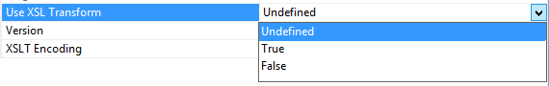
TIP #14 – Migrating Maps
XslCompiledTransform is not compatible with my maps!
You can consider configuring the transformations in “the old fashioned way” by adding DWORD UseXslTransform with value 1.
For 64 bit BizTalk host instances: HKLM\SOFTWARE\Microsoft\BizTalk Server\3.0\Configuration
For 32 bit BizTalk host instances and Visual Studio’s Test Map functionality: HKLM\SOFTWARE\Wow6432Node\Microsoft\BizTalk Server\3.0\Configuration
The problem with this approach is?
Will lose the many performance and memory usage improvements provided by the XSLCompiledTransform class
And the answer is install BTS 2013R2 CU2!
Backward compatibility option to use XslTransform instead of XslCompileTransform is available at map level
Notes:
It is possible to extend the framework by writing your own:
MetaInstruction and Instruction classes in assemblies
which should be deployed to the GAC
Creating vocabulary definitions that correspond to public methods on your MetaInstructions, and then using the AddMetaInstruction vocabulary definition in the BREPipelineFramework vocabulary in InstructionLoaderPolicy BRE Policies which will allow you to use the your custom vocabularies in the ExecutionPolicy.

Slide 29
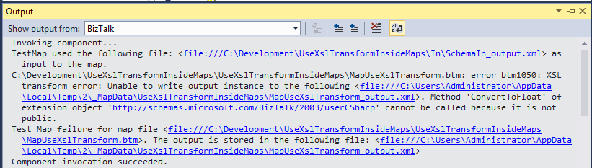
TIP #14 – Migrating Maps
The problem with this approach is?
You cannot test your maps inside Visual Studio if you use XslTransform compatibility option!
So, WHAT’S THE POINT OF USING IT?
My suggestion is…
You may loose more time adjusting the maps to the new engine… it will be painful must of the times… but it’s the best way that we have for now.

Slide 30
TIP #15 – Using BRE to help you implementing CBR
BizTalk Business Rules Engine Pipeline Framework
The BizTalk BRE Pipeline Framework leverages the Business Rules Engine (BRE) to abstract away logic to be exercised in BizTalk pipelines thus catering for increased development flexibility and agility.
But can we extend these capabilities?
Extend BizTalk Business Rules Engine Pipeline Framework capabilities?
Extend BRE capabilities, like calling static methods?
And the answer is YES, we can!
By default, the rule engine requires you to assert an instance of a .NET class to execute a policy that invokes a static member of the .NET class.
You can modify this behavior by changing the value of the “StaticSupport” registry key under:
HKEY_LOCAL_MACHINE\Software\Wow6432Node \Microsoft\BusinessRules\3.0
https://brepipelineframework.codeplex.com/documentation
Notes:
It is possible to extend the framework by writing your own:
MetaInstruction and Instruction classes in assemblies
which should be deployed to the GAC
Creating vocabulary definitions that correspond to public methods on your MetaInstructions, and then using the AddMetaInstruction vocabulary definition in the BREPipelineFramework vocabulary in InstructionLoaderPolicy BRE Policies which will allow you to use the your custom vocabularies in the ExecutionPolicy.

Slide 31
TIP #16 – Creating Custom Functoids
SetExternalFunctionName
this.Category = FunctoidCategory.String;
this.SetMinParams(3);
this.SetMaxParams(3);
…
SetExternalFunctionName(GetType().Assembly.FullName, GetType().FullName, "Compare");
…
public bool Compare(string strA, string strB, bool ignoreCase)
{
if (string.Compare(strA, strB, ignoreCase) == 0)
return true;
return false;
}
SetScriptBuffer
…
SetScriptBuffer(ScriptType.CSharp, this.GetCSharpBuffer());
…
private string GetCSharpBuffer()
{
StringBuilder builder = new StringBuilder();
builder.Append("public bool Compare(string strA, string strB, string ignoreCase)\n");
builder.Append("{\n");
builder.Append("\tbool isToIgnoreCase = false;\n");
builder.Append("\tbool outBooleanResult = bool.TryParse(ignoreCase, out isToIgnoreCase);\n");
builder.Append("\tif (string.Compare(strA, strB, isToIgnoreCase) == 0)\n");
builder.Append("\t\treturn true;\n");
builder.Append("\treturn false;\n");
builder.Append("}\n");
return builder.ToString();
}
Notes:
Normally when we create a custom functoid they need to be copy to
the “Developer Tools\Mapper Extensions” folder under the BizTalk installation path
and install in the Global assembly cache (GAC)
However this is not entirely true
When developer a custom functoid you need to be aware that we have two types of Functoids
Normally we use the SetExternalFunctionName expression to define the action of this functoid
In this case we are basically saying that we will use an external assembly to perform this action and in this case this assembly needs to be installed in the GAC in all the environments that you will use this functoid
However we have available another expression to define the action of the functoid… by using the SetScriptBuffer expression.
What’s the difference between both?
Well do you know what’s happen when you use an out-of-the-box string Functoid in your map? The C# code will be embedded in the XSLT code that will be deployed… and in this case you don’t need to deploy any assembly to your environment
This is basically what happens when you use the SetScriptBuffer expression, this type of functoid will tell the BizTalk Map to embed the function in the XSLT code…
The assembly of this Functoid will only need to be copy to “Developer Tools\Mapper Extensions” folder in your developing environment and you don’t need to install nothing in production

Slide 32
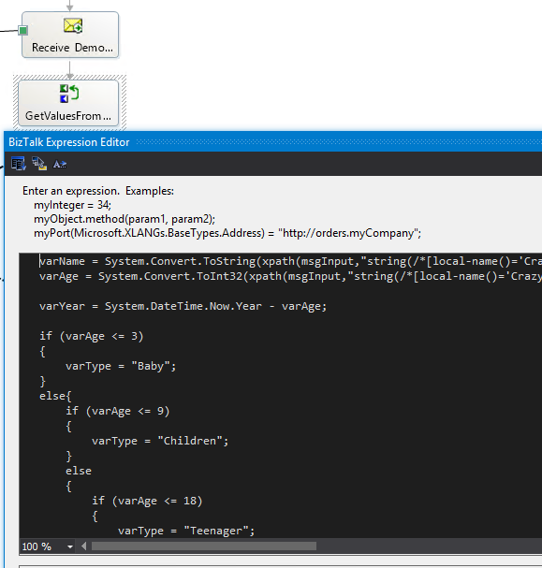
TIP #17 – Debugging orchestrations inside Visual Studio
Have you ever inherited orchestrations full of C# code inside expression shapes?
Something is failing and you really don't know why!
And before you redo it... you need to understand what is happening
Would not be nice, sometimes, to be able to debug this C# code inside Visual Studio?
A tool familiar to all developers
Maps (.btm.cs), Schemas (.xsd.cs), Pipelines (.btp.cs) generate “.cs” files in the source folder
However Orchestration “.cs” files are placed in the
obj\Debug\BizTalk\XLang folder
renamed as File0.cs, File1.cs etc

Slide 33
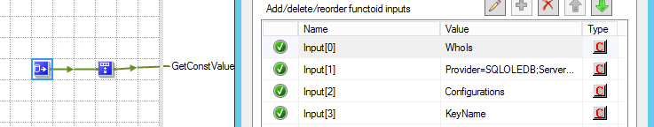
TIP #18 – Database Lookup
Parameter 2 What is the correct value for the connection string?
Easiest way is to….
Create a Universal Data Link (.udl) File
Select the OLE DB provider, the connection parameters, test the connection and click ok
Open the file in notepad and you will have the connection string
https://msdn.microsoft.com/en-us/library/e38h511e%28v=vs.71%29.aspx
Important considerations
Hard-coding the SQL connection strings might lead to maintenance overhead and serviceability issues.
You can and you should store this parameter in a different storage location (SSO, Registry or others)
Get this value using a scripting Functoid or custom functoid which can then be linked to the Database Lookup Functoid
http://www.biztalk360.com/biztalk-mapping-patterns/
Notes:
Let’s start with an easy and simple tip: Database Lookup Functoid
I always find hard to remember the correct value for the connection string to be used inside this functoid
The Easiest way to make sure we are using the correct connection string value and for not having to remember this by head is to create a simple Universal Data Link (.udl) File… set OLE DB provider connection parameters and test the connection to check if everything is correct
After data Open the file in notepad and you will find the connection string value that you can copy and use in the functoid
Important considerations:
You shouldn’t Hard-coding this value directly in the functoid otherwise it will be a nightmare when you deploy this to a different environment.
You can and you should store this parameter in a different storage location (SSO, Registry or others) and get this value using a scripting Functoid or custom functoid which can then be linked to the Database Lookup Functoid

Slide 34
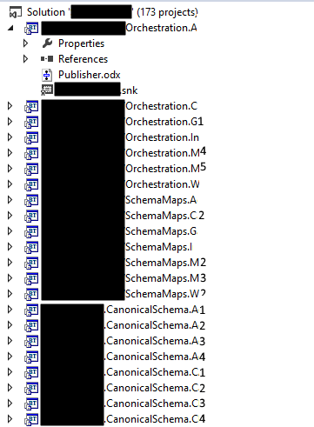
TIP #19 – DevOps: PowerShell is your friend!
What happens when we exaggerate in Visual Studio Structure?
1 Solution containing +170 projects!
Is a developer NIGHTMARE!
Find dependencies, find something!
~30 min to deploy!
What happens when you are migrating this project or a new developer joins?
You need to fix Signing Properties for all BizTalk Project
You need to fix Deployment Properties for all BizTalk Project
How to fix or configure the Deployment Properties of a BizTalk Project with PowerShell (https://goo.gl/7Afo0k)
How to fix or configure the Signing Properties of a BizTalk Project with PowerShell (https://goo.gl/acDzRN)
Notes:
It is possible to extend the framework by writing your own:
MetaInstruction and Instruction classes in assemblies
which should be deployed to the GAC
Creating vocabulary definitions that correspond to public methods on your MetaInstructions, and then using the AddMetaInstruction vocabulary definition in the BREPipelineFramework vocabulary in InstructionLoaderPolicy BRE Policies which will allow you to use the your custom vocabularies in the ExecutionPolicy.

Slide 35




TIP #20 – Be confident
Your body language affects how others see us, but it may also change how we see ourselves
Standing in a posture of confidence, even when we don’t feel confident — can affect testosterone and cortisol levels in the brain, and might even have an impact on our chances for success.
http://www.ted.com/talks/amy_cuddy_your_body_language_shapes_who_you_are

Slide 36

Director's cut…

Slide 37
TIP #21 – Full Backup will only happen 1 time per day
Full Backup only happen 1 time per day
BizTalk Server databases should be backed up and BizTalk Server will provide out-of-the-box a job for accomplished that: Backup BizTalk Server (BizTalkMgmtDb) job
To Force a full Backup
We need to use the “sp_ForceFullBackup” stored procedure available in BizTalkMgmtDb DB.
Mark the ForceFull column to 1 in the adm_BackupSettings table
A different way to Force a Full Backup
Create a new SQL Server jobs that
call the “BizTalkMgmtDb.dbo.sp_ForceFullBackup” stored procedure
call the standard Backup BizTalk Server (BizTalkMgmtDb) job
https://gallery.technet.microsoft.com/Force-Full-Backup-BizTalk-b4431508
https://gallery.technet.microsoft.com/Force-Full-Backup-BizTalk-b4431508

Slide 38
TIP #22 – Validating RosettaNet messages
Extending BTARN with a New PIP
Add Existing Item dialog box, move to <drive>:\Program Files\Microsoft BizTalk 2009 Accelerator for RosettaNet\SDK\Schemas, select xml.xsd, then click Add.
You need to fix the xml.xsd import in the new PIP Schema with a reference to the previous schema add to the solution
However when you use a Map to transform an incoming message to a PIP message you will get this error while validating inside VS:
Output validation error: Prefix 'ns2' cannot be mapped to namespace name reserved for "xml" or "xmlns". Line 1, position 215.
Workaround to validate the message against the schema
Set the Validate Testmap Output property of your map has False
Open the result message of the transformation inside visual studio and delete the following namespace from the message:
xmlns:ns2="http://www.w3.org/XML/1998/namespace"
And now validate this message against the PIP Schema
https://msdn.microsoft.com/en-us/library/bb950204%28v=bts.10%29.aspx

Slide 39
TIP #23 – RosettaNet Gotchas
Installation
BizTalk Accelerator for RosettaNet is available in the BizTalk Server installation disk (ISO) under:
“BizTalk Accelerators” folder
BtarnAPP Web application is referencing .NET Framework 2.0
You need to create a WebService extension for BTSHTTPReceive.dll, configuring the IIS isolation mode.
BTARN does not support the use of alias created for SQL instance to configure the BTARN database
Requires IIS_WPG group
Host Instances
The accelerator requires both in-process and isolated host to be marked as "Authentication Trusted" and "32-bit only“
The BizTalk Host Instance Account and the BizTalk Isolated Host Instance Account should be the same
Do never use Full Qualify domain name in the Logon credentials
Make sure the BTARN in-process host is the default send handler of HTTP Adapter
BAM
BTARN supports enhanced tracking using BizTalk Activity Monitoring (BAM).
Right-click the BizTalk Accelerator for RosettaNet node and then click Properties.
In the Global Properties dialog box, select Enable BAM Tracking to enable tracking, or clear this option to disable it.
Microsoft provide a Tracking file with the activity definitions however:
The tracking points are not customizable; do not change activity definitions.
You can Manage BAM views and deployment.
Databases Maintenance
Remember TIP #1
BTARN database are not backuped by default
There are no maintenance processes to clean up this database
BTARN databases can grow quickly because they contain the PIP XML that you are processing
They can effect the performance of your environment
There are important
You need to create this maintenance processes according to the legal requirements of the company
Notes:
Understanding RosettaNet can be a challenger believe me so in this tip I will provide some important topics that you need to be aware about it:
BTARN require:
Microsoft .NET Framework 4.5
If you have multiple versions of .NET Framework installed on your computer, make sure that the BtarnAPP Web application is referencing .NET Framework 2.0. You can configure this by using the Internet Information Services (IIS) Manager.
DESPITE the BtarnAPP Web application working properly in .NET 4.0
You need to create a WebService extension for BTSHTTPReceive.dll, configuring the IIS isolation mode.
The BizTalk Host Instance Account and the BizTalk Isolated Host Instance Account should be the same. Otherwise, BTARN will not function correctly.
If the service account set for the BTARN application pools is different from the Isolated Host account, BTARN will not be able to process incoming messages correctly. When the receive .aspx page calls the pipeline, the pipeline will not have access to the appropriate certificates. Therefore, it will not be able to decrypt the incoming message or validate the signature. It will also not be able to access the MessageBox database.
BTARN does not support the use of alias created for SQL instance to configure the BTARN database.
RosettaNet requires the IIS_WPG group (group provided by IIS 6.0 that provides the minimum set of user rights and permissions required to run an application) unfortunately for us this group doesn’t exist anymore… so you need to create it manually
Very important: The accelerator requires both in-process and isolated host to be marked as "Authentication Trusted" and "32-bit only“. And the reason why in-process need to be also trusted is that the BizTalk Host Instance Account and the BizTalk Isolated Host Instance Account should be the same and you cannot use the same account for trusted and untrusted… otherwise it was only necessary to mark the isolated host as trusted.
Important: Make sure the BTARN in-process host is the default send handler of HTTP Adapter, when you create a Partner it will create to send ports and it will use the default send handler, if the BTARN in-process host you need to stop the BTARN process unbinding the send ports fix the send handler and start everything again… so it induce a small shutting down
BTARN supports enhanced tracking using BizTalk Activity Monitoring (BAM).
Microsoft provide a Tracking file with the activity definitions however: you need to you BAM views
There are no maintenance processes to clean up this database

Slide 40

Thanks
sandro.pereira@devscope.net
linkedin.com/in/sandropereira
@sandro_asp
sandroaspbiztalkblog.wordpress.com
+351 223 751 350
www.devscope.net

Slide 41
THANK YOU TO OUR SPONSORS

